Slide 1
DOE OE Energy Storage Program PEER REVIEW: POSTER Instructions & EXAMPLES
INSTRUCTIONS:
Using a 30x40 template, create a technical poster summarizing your FY26 funded project, including work completed and results. Follow the outline below for consistency. An example is provided on slide 2.
Title Section: Enter the title of your poster. Ensure it is concise and reflects the main focus of your research.
Authors: List all authors in the order of contribution.
Project profile: topic area, vertical, strategic alignment, and duration: Clearly label the poster with the project’s topic area, vertical(s), and which DOE/OE strategic pathway(s) it supports. These labels are provided below for reference.
Problem: Outline the background and significance of your research. State the problem you are addressing and the objectives of your study.
Approach: Describe the methodology used in your research. Include any experimental design, data collection, and analysis techniques.
Results: Present the key findings of your research. Use graphs, charts, and tables where appropriate to illustrate your data clearly.
Conclusions & Impact: Interpret your results and discuss their implications. Summarize the main takeaways from your research and current or expected impacts.
Future Directions: Summarize the main takeaways from your research. Suggest future research directions if applicable.
References: Include citations for any sources referenced in your poster.
Acknowledgments: Include the OE funding acknowledgement statement and recognize any individuals or organizations that contributed to your research or provided funding.
Visual Design: Use a clear layout, legible fonts, and appropriate color schemes. Avoid clutter and ensure that all text is easy to read from a distance of 2-3 feet. Include relevant figures or graphics.
Note for presenters from Argonne, Oak Ridge, and PNNL, etc.: You must use this outline, however, you do not need to use the Sandia-branded powerpoint presentation template. Instead, please copy and paste this outline into your organization’s presentation templates
Additional Notes & Instructions: Please strive to allocate 30-40% of your poster to results, conclusions, and impact. Project posters and poster presentations will be evaluated against the rubric(s) provided.
To submit your poster, save your completed poster as a .PPTX file and follow all instructions at doepeerreview.sandia.gov. Ensure it meets the specified dimensions, file naming conventions, and file size limits. Submit your poster by the designated deadline.
If you have any questions or need assistance, please reach out to the event coordinator.
Topic Areas | Verticals | Strategic Pathways
This label is used by event organizers to sort and place posters in the correct locations for the event and reviewers. | This label is intended to help audiences understand which investment area this effort or project is connected to. | This label is intended to help audiences understand project alignment to the strategic pathways outlined in OE’s strategic plan.
Analytics & Tools | Safety & Reliability | Stabilize: Addressing urgent, emergency conditions to ensure safety, reliability, and system security
Demonstration Projects | Grid Integration and Field Validation
Flow Batteries | Analytics
Grid Resilience & Reliability | Materials and Systems Innovation | Optimize: Enhancing grid performance and strengthening security through robust consideration of available technology options and process improvements
Next Generation, Large Scale Energy Storage
Power Electronics
Regulatory
Safety & Reliability |  | Grow: Long-term expansion by enabling innovation, advancing new technologies, and building capacity for a future-ready electricity system
Sodium Batteries
Zinc & Lead Batteries
TIPS:
Reviewers are experts and professionals from the energy storage sector, but may not be specialists in your area and have limited time per poster presentation. To help reviewers and attendees quickly grasp your project’s purpose, approach, and impact:
Keep text concise and to the point.
Minimize jargon and spell out acronyms on first use
Use bullet points for clarity.
Ensure all visuals are high quality and relevant.
Proofread for spelling and grammatical errors before submission.
Sandia National Laboratories is a multimission laboratory managed and operated by National Technology & Engineering Solutions of Sandia, LLC, a wholly owned subsidiary of Honeywell International Inc., for the U.S. Department of Energy’s National Nuclear Security Administration under contract DE-NA0003525.
Click to add SAND XXXX-XXXX P

Slide 2
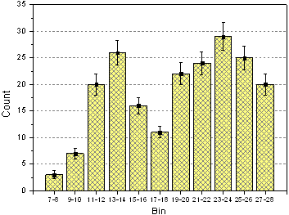
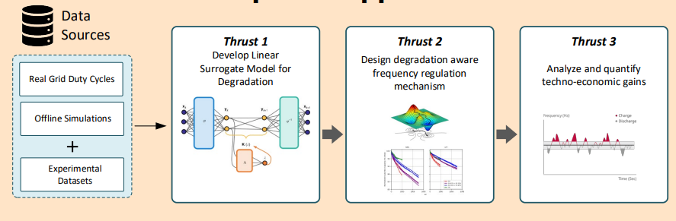
Title up to two lines
List authors in order of contribution here. Include full names and affiliations. E.g, First Name Last Name (1), etc, etc.
Add author affiliations here. E.g., (1) Sandia National Laboratories, (2) University of New Mexico, etc. ,etc.
PROJECT PROFILE
Topic: [Insert topic] | Vertical: [Insert vertical]
Strategic Pathway: [Insert pathway]
Project start and finish: FY2X-FY2X
RESULTS
Present the key findings of your research. Use graphs, charts, and tables where appropriate to illustrate your data clearly.
PROBLEM
Outline the background and significance of your research. What problem are you addressing? What are your objectives?
What is the problem? Why is it hard?
What is the motivation (tie to national need(s))? Why now?
How is the problem solved today? What are the limits of current practice?
Consider using bullets to summarize
Use images to illustrate if appropriate
Fig. 2. Results suggest that XXYZZ.
CONCLUSIONS & IMPACT
APPROACH
Briefly interpret your results and discuss their implications. i.e., Who cares? If you succeed, what is the impact?
Summarize the main takeaways from your research and current or expected impacts.
If your project includes quantifiable impacts or metrics, please consider including them.
Include near-term wins, if possible. (e.g., new innovations, patents, benefits to industry.)
Describe the methodology used in your research.
How are you approaching the problem? Why this approach?
Are there unique lab capabilities you are leveraging/using in your approach? If so, consider mentioning them to help audiences understand why your national lab/team is the optimal place to conduct this research.
FUTURE DIRECTIONS
Help reviewers understand what is next.
What are you doing next (e.g., for the remainder of the project)?
Where do you see this research or effort going in the future?
Fig. 1. An example of an image or chart caption.
References
If applicable, list references/citations here.
This material is based upon work supported by the U.S. Department of Energy, Office of Electricity (OE), Energy Storage Division.
Sandia National Laboratories is a multimission laboratory managed and operated by National Technology & Engineering Solutions of Sandia, LLC, a wholly owned subsidiary of Honeywell International Inc., for the U.S. Department of Energy’s National Nuclear Security Administration under contract DE-NA0003525.
Click to add SAND XXXX-XXXX P

